Slide 1
Version control
Installing and Setting-Up Git

Slide 2

Sign Up
Git is the software that runs on your device. It allows versioning of your code
Github is the website that allows you to interface with the code history
https://github.com/
Provide Your Desired Username (might need to make sure it has not been taken), Email and Password and Sign UP

Slide 3
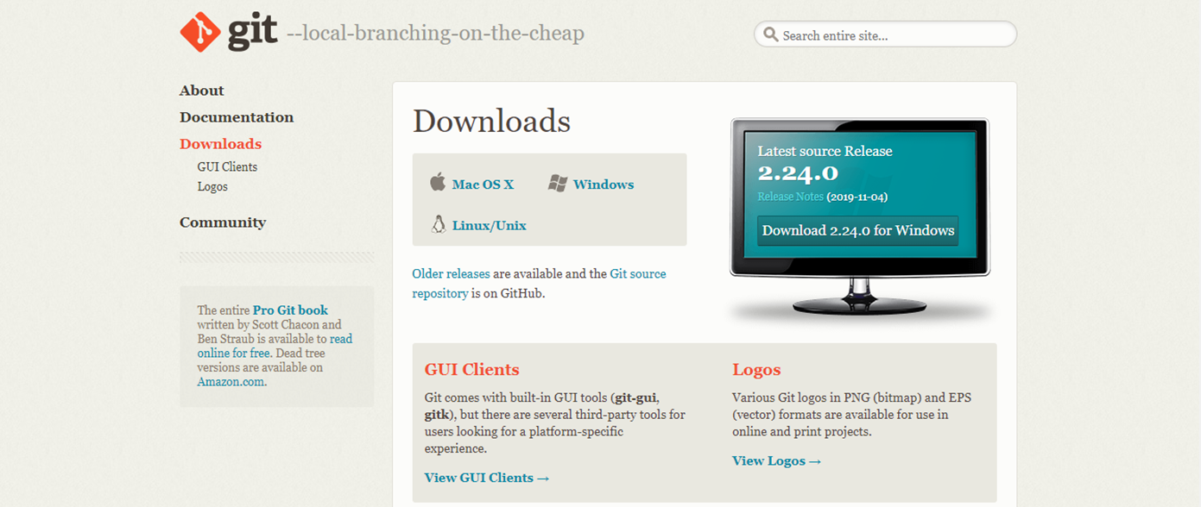
Installing Git
https://git-scm.com/downloads
On Windows: https://gitforwindows.org/
I highly suggest installing GitBash on windows as it makes SSH handling very easy

Slide 4
Creating and Adding SSH key
You should set your Github username and email, then add your SSH key to your GitHub profile
https://git-scm.com/book/en/v2/Customizing-Git-Git-Configuration
https://help.github.com/en/github/authenticating-to-github/connecting-to-github-with-ssh
https://help.github.com/en/github/authenticating-to-github/adding-a-new-ssh-key-to-your-github-account

